Slide 1
SUPERDETAILING FREIGHT CARS (FOR AP MERIT AWARDS)

Slide 2
Intro – why this topic
Several threads dangling and available
Never done before in discussion
Division 3 has great modelers
-- who has built a craftsman kit?
-- who has scratch built a model?
-- who in Division 3 has a Merit Award for Cars?
-- who in Division 3 has the AP Certificate for Cars? Bob, Allen

Slide 3
Phil Gliebe Inspiration (another dangling strand)
At MCR Convention Banquet, Phil kept going up for first places
Phil submitted 6 entries in the regional convention contest
Phil won 3 first place plaques, 2 second place, 1 honorable mention
All 6 entries won Merit Award (87.5 or more points out of 125)
1 engine; 5 cars
Together with previous merit awards, Phil should qualify for Motive Power and Cars Certificates

Slide 4
Phil’s 6 Merit Award Winners

Slide 6
So what does it take to super detail a freight car to an AP Merit Award
What are those cars that we love (to model) so much?
Another dangling strand – History and Development of freight cars
Heritage goes to first trains in England in 1820’s; in US in 1830’s
-- passenger cars evolved from stage coaches
-- first freight cars were flat cars; 2 rigid axles, 2 wheels, short

Slide 7
Need created categories
-- sides and ends led to gondolas
-- plus top and doors led to box cars
-- open slats for air led to stock cars
-- insulation for ice led to reefer cars
-- barrels led to tank cars
-- shoots led to hopper cars
-- trailer capability led to piggy back cars
-- intermodals, spine cars, depressed flat cars, etc

Slide 8
Improvements:
-- wood 1820-1880’s
-- iron then steel 1870’s to present
-- automatic air brakes
-- trucks (single axle, double axle, journals, springs, etc)
-- knuckle couplers
-- universal standard gauge
-- construction, siding, bracing, etc
All help provide structural support, truck wear reduction, easier curves

Slide 9
FREIGHT CAR TERMINOLOGY:
Trucks: separate 9000 lb unit to include axles, wheels, side frames held together by gravity and interlocking parts to provide support
Journal bearings: load bearing parts at end of axle (friction & roller)
Wheels: cast or forged steel, 70 ton on 33” wheels; 100-125 ton cars on 36 and 38” wheels
Axles: steel shafts to mount wheels to the width of track gauge 4ft 8.5 in. Also transmit load from journal bearings to wheels: 1200 lbs
Carbody; gravity holds carbody in place on the trucks

Slide 10
Center Sill: load bearing bridge on carbody unit supported at center of both trucks. Carbodies are built of steel.
Truss:
Bolster:
Outmoded parts: running boards, full height safety ladders

Slide 16
Standardization of designs
USRA (RR ADMIN): 1917-1920 standard designs for over 100K cars
ARA (AMER RR ASSOC): 1920-1932
AAR (AMER ASSOC RR): 1932

Slide 17
Design - -
As shippers requested specialization to handle specific products, new characteristics were born
--20’, 30’, 40’, 50’, 70’, 80’, and longer
Single sheath, double sheath, steel ends, single door, double door,
outside braces, insulation, refrigeration units, cat walks, etc
-- 1960’s – Federal Railroad Administration set 50 year shelf life on all cars; overhaul every 10 years; retire all wooden cars
-- Now 7 basic categories: box car, flat car, gondola, tank car, hopper, autoracks, and well/spine car
-- Discuss construction technique development
-- How to handle STRESS

Slide 18
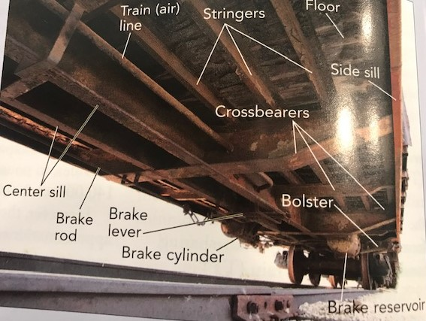
Diagram of early flat car construction

Slide 19
Let’s move our focus to box cars
Why are we so fascinated with freight cars, namely box cars?
1900-1960: over 250 different railroads in US
up to 1980, 251,000 box cars; all sizes, all colors
and 179,000 insulated and specialized box cars
(after 2010 – 95,000 box cars
You can literally pick and chose from so many prototypes

Slide 20
Next dangling thread
How do we model box cars? What is available to us?
RTR (Lifelike, Bachmann, Athern, Tyco, InterMountain, Kaydee, etc)
What about the details? Most included in die and molded into car
What is your degree of satisfaction with these RTR cars?
Kits (styrene, resin, metal, and wood)
Kit Bash
Craftsman kits (assemble all parts and paint and apply decals)
Scratchbuilt cars YOUR OPINIONS OF THESE DIFFERENT APPROACHES

Slide 21
Next Dangling Thread
What about building to the standard set by the NMRA AP?
Craftsman kit or scratch build according to published or your plans
Judged according to a standard
Pointed in categories; 125 max points; 87.5 earn a Merit Award
2 judges: at convention contest; at division meeting; at appointment
Documentation is key; did you do what you say you wanted to do?
Phil Gliebe’s comments; others who have entered a contest remarks

Slide 22
My experience at building to a standard: 3 diaramas
Have been judged middle of the pack; lost scratch built points
Too many purchased items
Not detailed enough
Not in scale (vehicles, signs)
Need more of a modelling effort

Slide 23
What is needed to super detail a craftsman kit or a scratch built car?
Close to prototype or hand drawn plans
No visible glue or overruns
No mismatched joints unless documented intentionally
Weathered: inside, outside, under, wheels, operational parts
Paint: no overruns, no drips, realistic
Decals: look natural, not shiny, not raised, use dull coat; dry transfers

Slide 24
Use detail parts: make your own grab irons, hand rails, etc; brake wheels, placard boards, number boards, ladders, cat walk, windows, inside details (open top),
Underside: brake lines and air cylinders, painted and weathered
Trucks and wheels: painted and weathered
Realistic couplers
The more of these the better, and document them!

Slide 25
Judges look at overall appearance and how the model conforms to different point categories; make sure you get points in all categories
Weathered appearance; paint appearance, decal appearance, detail parts, scratch built parts, documentation (refer to Phil’s documentation)
Lose points: bad construction, bad paint, bad decals, no scratchbuilt parts, no detail parts, no good documentation of your intent, obvious scale deficiencies

Slide 26
This discussion applies to all scales
Which approach to modelling do you prefer?
What tips can you offer?
What mistakes have you made?
Have you entered a contest and earned a merit award?
Have you entered a contest and fell short in points? What happened?
Where to get your detail parts?
Based on this presentation, are you willing to have your model judged? I will help with the paperwork.

Slide 27
I decided to build a craftsman Ambroid 40 foot, single sheath box car and detail it in Akron, Canton, Youngstown reefer yellow colors
Issues: directions sparse, kind of glue, how to glue, how to brace, how to construction, how to apply decals/dry transfers, how to dull coat, how to paint, when to paint, paint the inside, how to sand, how to prime, how to correct mistakes
When I finish, I will have it judged either locally or at a convention contest
Any pointers? Questions?

Slide 28
References:
FREIGHT CAR HANDBOOK BY STEPHEN PRIEST
FREIGHT CARS OF THE 40’S AND 50’S BY JEFF WILSON
FREIGHT CAR PROJECTS AND IDEAS EDITED BY MODEL RR STAFF

